Slide 1
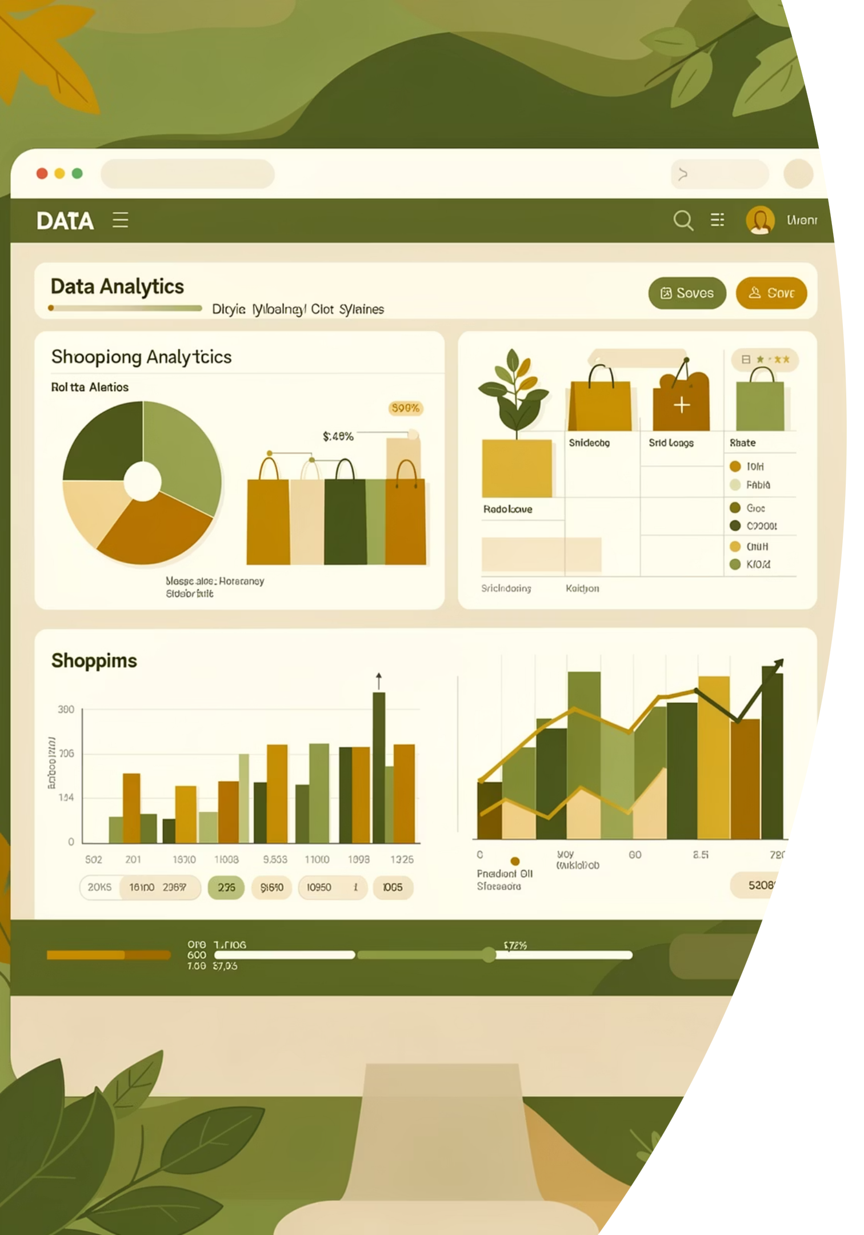
Customer Shopping Behavior Analysis
Uncovering spending patterns, customer segments, and product preferences from 3,900 transactions to guide strategic business decisions.

Slide 2
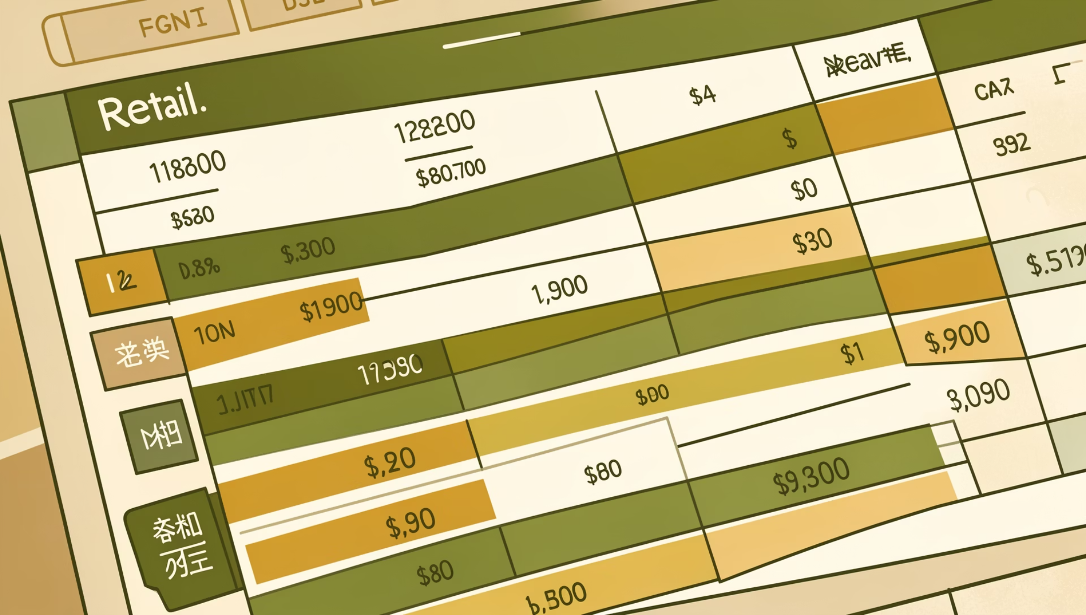
Dataset at a Glance
Key features include demographics, purchase details, and shopping behavior — from age and gender to discount usage and shipping type.
3,900 Rows
18 Columns
37 Missing
Transactions analyzed
Features per record
Review Rating nulls

Slide 3

Data Preparation in Python
01
Load & Explore
Imported with pandas; used df.info() and .describe() for structure checks.
02
Clean & Standardize
Imputed missing Review Ratings with category median; renamed columns to snake_case.
03
Feature Engineering
Created age_group bins and purchase_frequency_days; dropped redundant promo_code_used.
04
Load to PostgreSQL
Connected Python to PostgreSQL and loaded the cleaned DataFrame for SQL analysis.

Slide 4
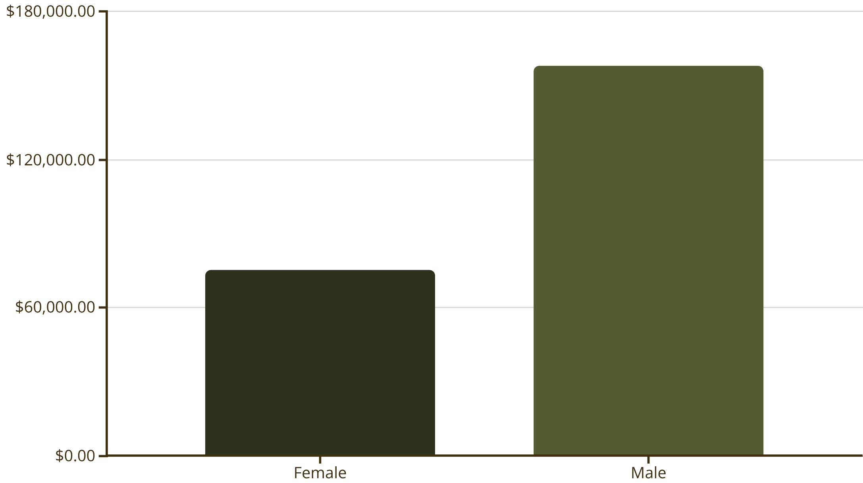
SQL Analysis: Revenue & Spending
Revenue by Gender
Male customers generated $157,890 vs. female customers at $75,191 — more than double the revenue contribution.
High-Spending Discount Users
839 customers used discounts yet still spent above the average purchase amount, signaling strong deal-driven engagement without margin collapse.

Slide 5
Top-Rated Products & Shipping
Top 5 Products by Avg. Rating
Shipping Type vs. Avg. Spend
Express shipping users spend slightly more, suggesting a higher-value customer segment worth targeting.
🧤 Gloves — 3.86
👡 Sandals — 3.84
👢 Boots — 3.82
🎩 Hat — 3.80
👗 Skirt — 3.78
Standard
Express
$58.46 avg. purchase
$60.48 avg. purchase

Slide 6
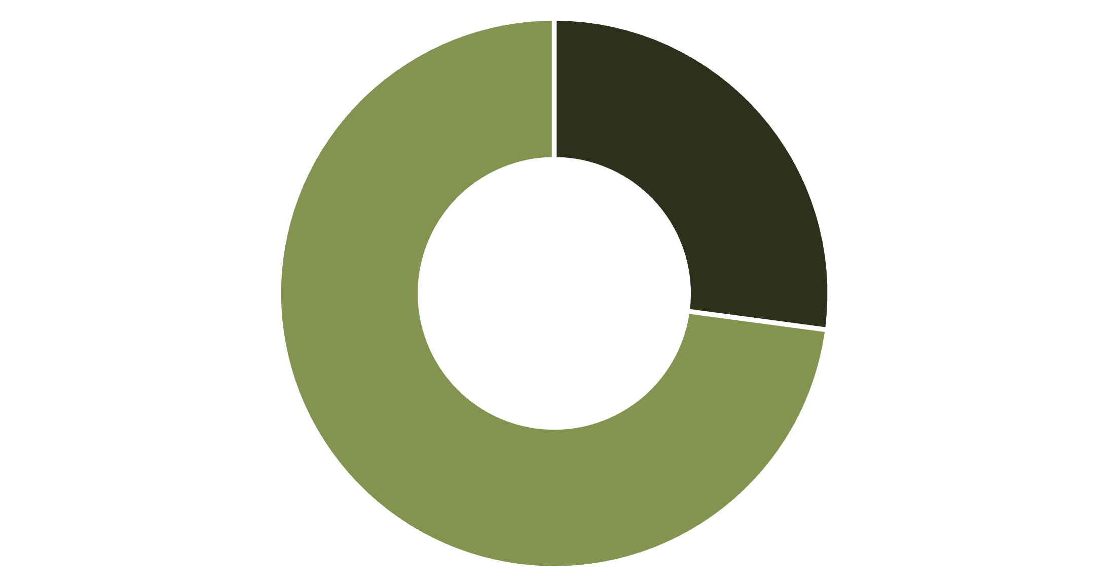
Subscribers vs. Non-Subscribers
Key Findings
Only 27% of customers are subscribers, yet both groups spend similarly (~$59–60 avg.).
Subscribers (1,053)
$59.49 avg spend · $62,645 total revenue
Non-Subscribers (2,847)
$59.87 avg spend · $170,436 total revenue
Subscribed
Not Subscribed

Slide 7

Customer Segmentation & Loyalty
3,116
701
83
Loyal
Returning
New
Customers with extensive purchase history
Repeat buyers building toward loyalty
First-time or early-stage customers
958
Repeat + Subscribed
Buyers with >5 purchases who subscribe

Slide 8
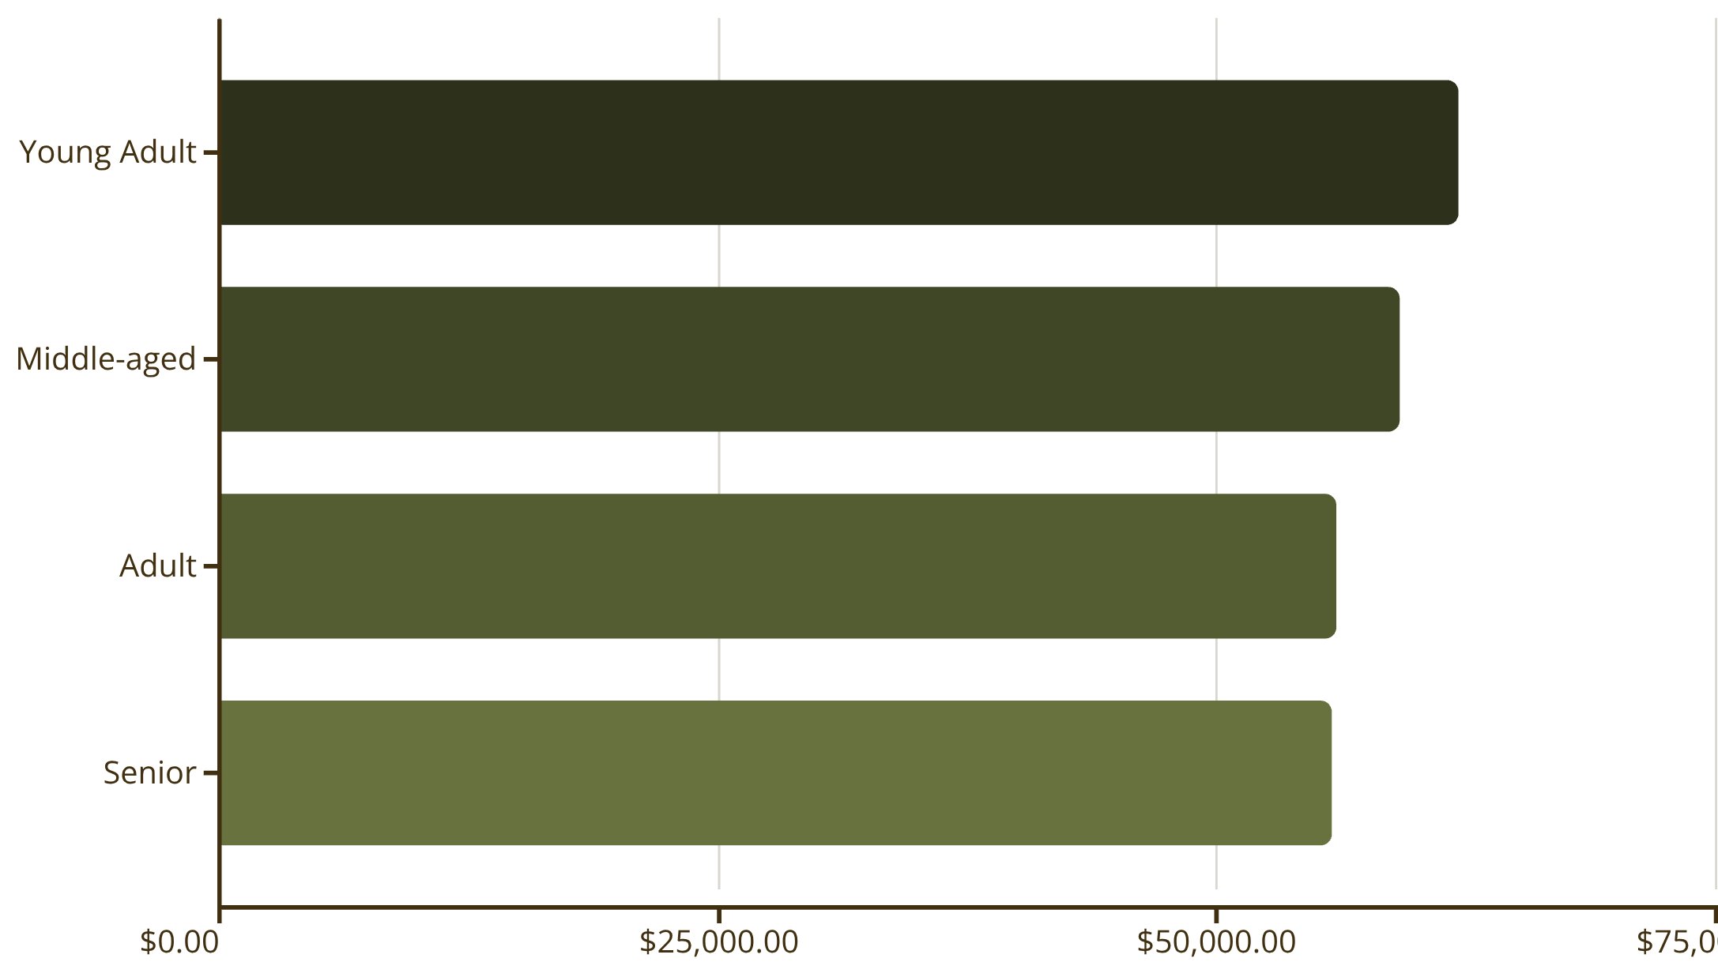
Top Products & Revenue by Age
Top Products per Category
Revenue by Age Group
Category
Top Item
Orders
Accessories
Jewelry
171
Clothing
Blouse / Pants
171
Footwear
Sandals
160
Outerwear
Jacket
163

Slide 9
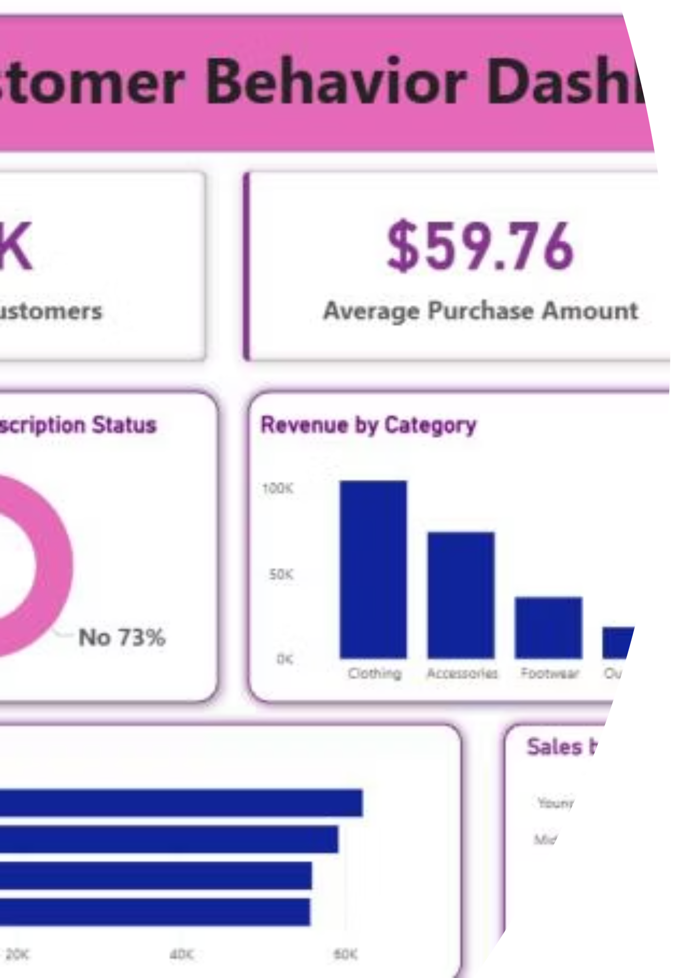
Power BI Dashboard
Interactive Power BI dashboard visualizing subscription status, revenue by category, sales volume, and age-group breakdowns — with filters for gender, category, and shipping type.

Slide 10


Business Recommendations
Boost Subscriptions
Promote exclusive benefits to convert the 73% non-subscriber base.
Loyalty Programs
Reward repeat buyers to accelerate movement into the "Loyal" segment.
Review Discount Policy
Balance sales boosts with margin control — 839 high spenders used discounts.
Targeted Marketing
Focus on Young Adults, high-revenue categories, and express-shipping users.

